Slide 1

Hestia Home Automatisation System
Simplify your life with our new iOS Client

Slide 2
Intro
Could we do something about this day to day inconveniences and to make our life easier?

Slide 3
Yes, we can.

Slide 4
What is Hestia?

Slide 5
What is Hestia?
Hestia is a system that was created in order to provide a stable platform which is extendable and makes it easy to control every smart device in a user’s home. Any such device will be able to connect to our system, thus creating an universal platform for the end user to use and simplifying his life.

Slide 6
User Stories

Slide 7
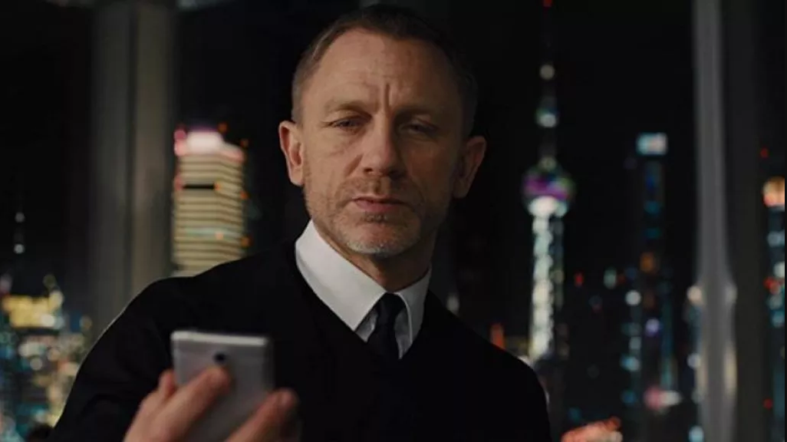
Meet Mr. Bond….Mr. James Bond

Slide 8
Mr Bond
What Mr Bond want is the ability to lock and unlock all the locks in his house while he is in a different part of the world. And because he is using an iPhone as his main phone, he would want to do it from his smartphone.

Slide 9
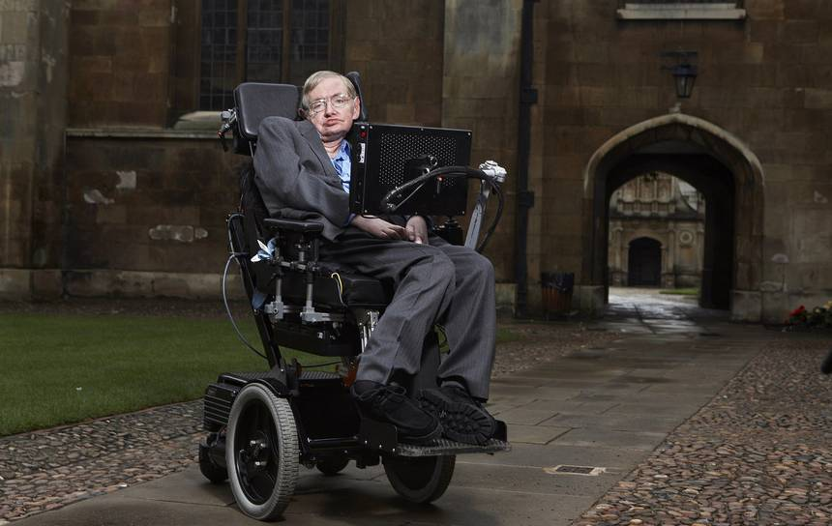
Meet Mr. Stephen Hawking

Slide 10
Mr Stephen Hawking
What Mr Hawking want is the ability to control all his house lights through his iPad.

Slide 11
“Work gives you meaning and purpose and life is empty without it.”
- Stephen Hawking -

Slide 12
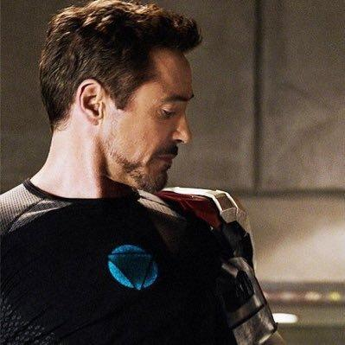
Meet Mr. Tony Stark / Iron Man

Slide 13
Mr Tony Stark
What Mr. Stark is looking for is a solution to automate the process of heating his house so he doesn’t need to do it himself and his limited amount of time he is spending at home be as comfortable as possible.

Slide 14
The Hestia iOS Application

Slide 15
The Hestia iOS Application
The main product that our team has focused on is developing an iOS client as many of our clients that we have shown before are using an Apple Device.

Slide 16
Front end
Notes:
Andrei has told you some general information about the app. I will explain the front end design of the app.

Slide 17
Native iOS look & feel
Inspiration from:
Clock app
Mail app
Music app
Contacts app
Settings screen
...
Notes:
Customer found it important that the app had a native iOS look and feel. Inspiration from… They should reflect the iOS look and feel.

Slide 18
User interface overview
Loading screen
Login
screen
Server connect screen
Devices main screen
Settings screen
Notes:
Tell something about the user interface structure of the app.

Slide 19
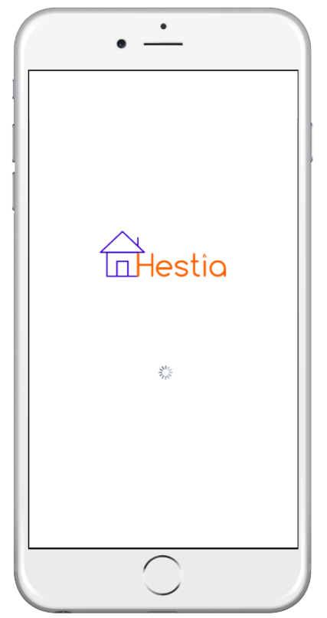
Loading screen
White screen
Hestia logo
Loading indicator
Notes:
Difference between the iOS standard apps and third party apps is that standard iOS app do not have a loading screen. Third party apps have loading screen, we choose to keep it simple and have a white screen with the logo and a loading indicator.

Slide 20
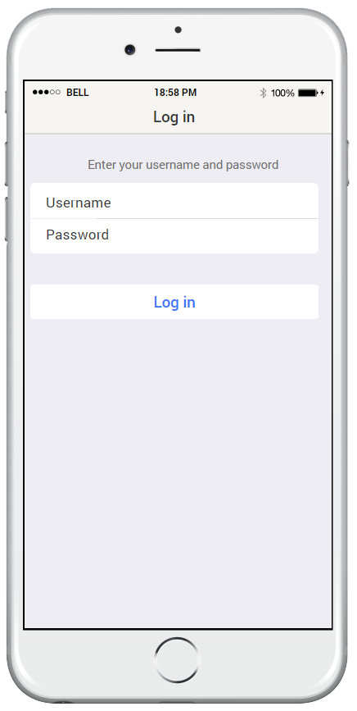
Login screen
Username/password
Login button in blue font

Slide 21
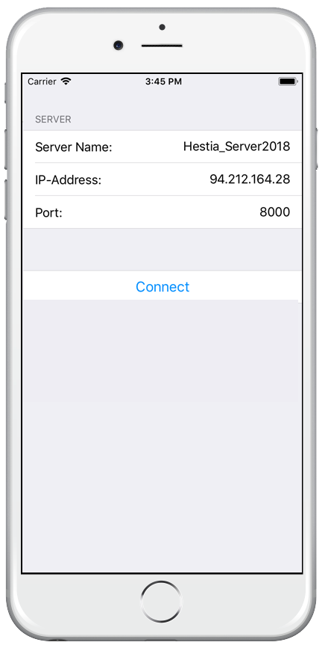
Server connect screen
Server name
IP address/port
Connect button in blue font

Slide 22
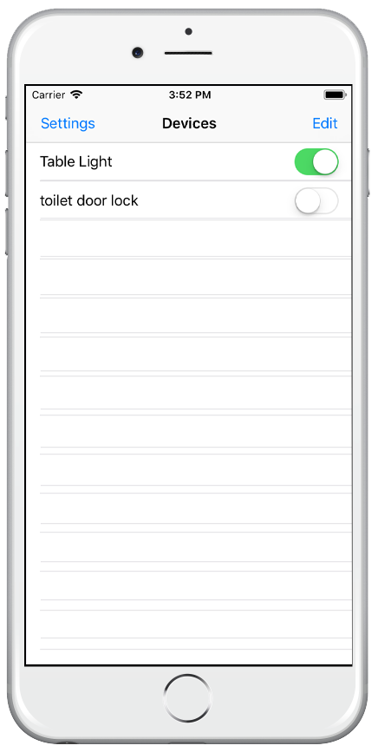
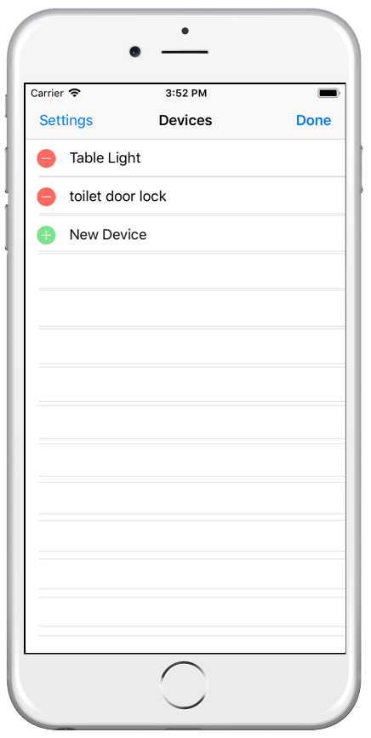
Devices main screen
List of devices
On/Off switch
Edit button
Settings button

Slide 23
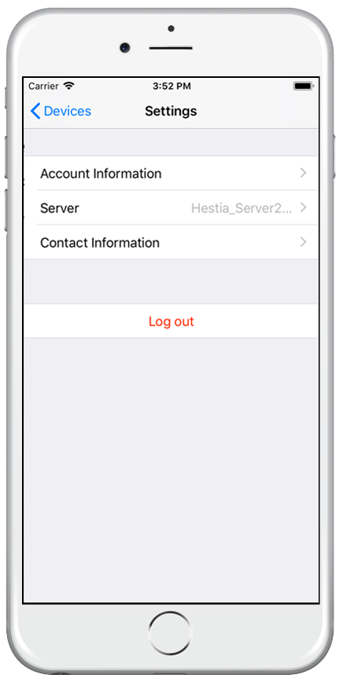
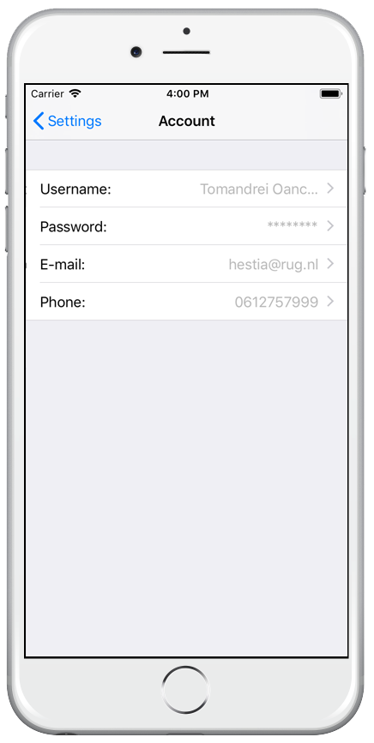
Settings screen
Account information
Server
Contact information

Slide 25
Front end
Native iOS look & feel

Slide 26
Back end
Simple, reliable, clear

Slide 27
All about the server interactor
Backend is built from the server interactor class, from there you will find a link to most other classes.
The server interactor uses other helper classes to execute the desired behavior.
Notes:
Talk about how the server interactor uses Models and Netword Handler to execute it’s behavior. Also talk about the useful functions in the server interactor.

Slide 28
Models
Most objects in the app have models to hold their data.
Device, Activator, ActivatorState
These models have helper classes that can change them to and from JSON code.

Slide 29
Network handler
Talks with the server.
Retrieves and sends JSON encoded data to and from the server.

Slide 30
Future
Voice control
Firebase integration with Webserver

Slide 31

Thanks!
Team of iOS Application :
Andrei Mădălin Oancă
Daan Groot Geanne Barkmeijer Juan José Méndez Torrero Jur Kroeze Marc Fleurke Tom den Boon Zino Holwerda

